Slide 1
Unit Two – Principles of Rehabilitation
Lesson Two: MAJOR Components of a Rehabilitation Program

Slide 2
Introduction/Classwork
On your own sheet of paper!
Think about the parts of a rehab program that we discussed the other day.
From your memory, or what you can find on the interwebs ( ☺ ), try to determine what “goes into” each component.
What is happening?
What interventions or modalities may be used?
What is the relevant terminology & what does it mean?
How does a patient move from step to step?
Etc!
Take your time!

Slide 3
Components of a Rehabilitation Program
Minimizing swelling
Controlling pain
Reestablishing neuromuscular control
Establishing or enhancing core stability
Regaining or improving range of motion
Restoring or increasing muscular strength & endurance
Regaining balance & postural control
Maintaining cardiorespiratory endurance
Incorporating functional progressions

Slide 4
Introduction: Part Deux
Who has had an injury that needed to be “rehabbed” with a clinician?
Go back waaaaaaaaay before your RTP experiences, describe the rehab process.

Slide 5
Objectives
Understand the necessity, factors, & tools used in each phase of the rehabilitation process
Use common rehab terminology

Slide 6
Minimizing *Initial Swelling
Rehab truly starts as soon as the injury does!
Acute injury management changes the whole rehab process
Things get worst, tissues sustain more damage, rehab takes longer
Almost all injuries swell during the INFLAMMATORY PHASE
Swelling that lingers too long is no longer serving its purpose
White blood cells, infection control, mineral reabsorption

Slide 8
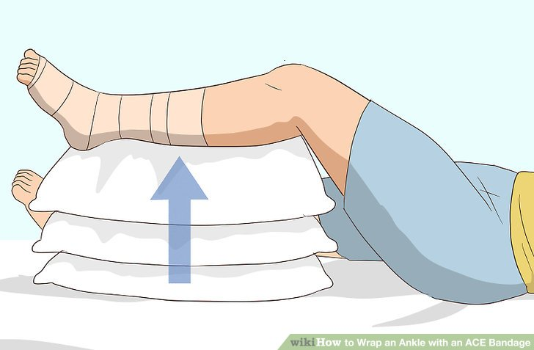
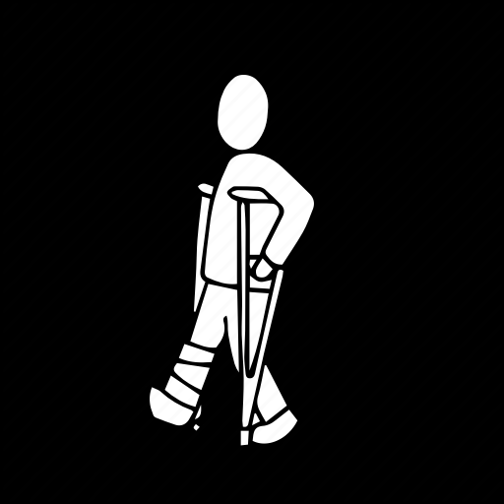
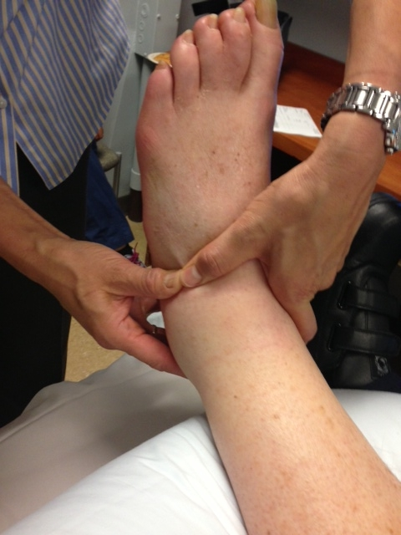
How do we manage swelling?
Protection
Immobilization prevents further pain/injury
Optimal loading
Excess weight, no matter how protected will still cause harm
Ice
Causes vasoconstriction to help control additional swelling
Compression
More prevention of additional swelling—when applied correctly
Elevation
Along with proper compression promotes lymphatic drainage to remove swelling

Slide 9
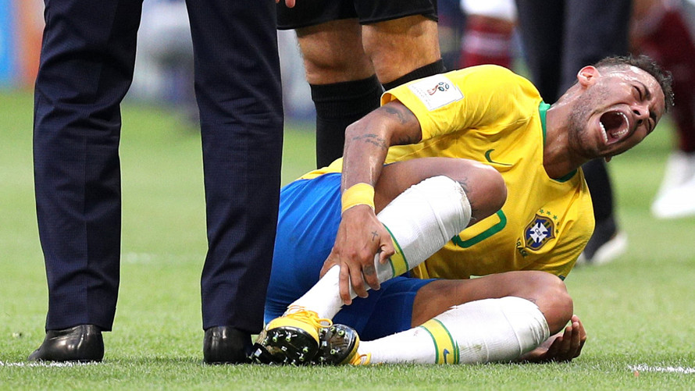
Controlling Pain
EVERYONE EXPERIENCES PAIN DIFFERENTLY!
Typically minor injuries elicit less pain, major injuries more.
Pain & injury are directly related!
Nerve damage will affect how much pain is felt, if any at all!
What is pain?
Can we always SEE it?

Slide 10
Pain Control Methods
Pain is nerves firing → pain relief involves controlling those nerves
Protect the injured limb so that the nerves aren’t stimulated
Load with only the appropriate amount of body weight & force
Ice to “dull” nerve signals—numbness
Compress & elevate to help swelling leave the area & relieve nerve stress!
Pain will also limit a patient’s progress through rehab. Why?
Unwilling to use full strength, ROM, balance, speed, etc.
Long-term unnecessary pain is detrimental to overall well being.

Slide 11
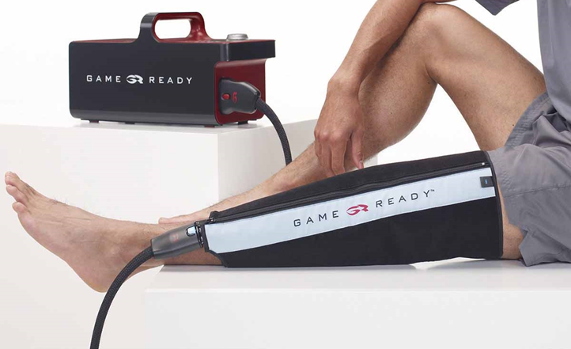
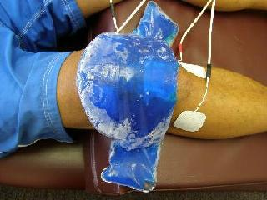
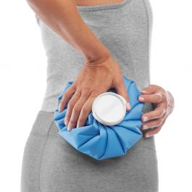
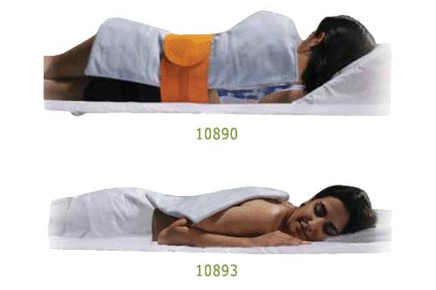
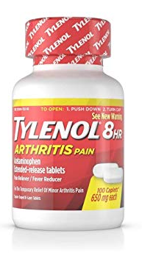

Slide 12
Reestablishing Neuromuscular Control
Neuromuscular control relies on the central nervous system, visual input from your brain, & communication between different types of receptors throughout your body
Usually the CNS or at least some of these receptors are affected during injury
This along with immobilization leads your body to forget how to move your muscles & joints together smoothly
Consciously & unconsciously → muscle memory
Proprioception & kinesthesia + dynamic stability + preparatory & reactive muscle characteristics + conscious & unconscious functional motor patterns = true neuromuscular control

Slide 13
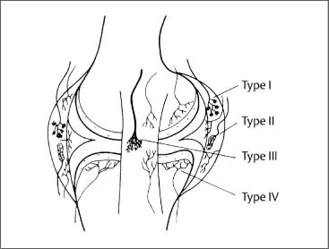
Types of Receptors
Ruffini corpuscles in the joint capsules, ligaments, & skin surrounding the joints constantly feel for changes in touch & tension, & the joint position, where & how fast it is moving
Pacinian, Merkel’s, & Meissner’s corpuscles are all in the skin feeling for changes in pressure—different depths & different rates
Muscle spindles in the muscle bellies respond to changes in length of the muscles
Golgi tendon organs sit in the musculotendinous junction to protect against too much tension

Slide 14
So what? How does this work?
The receptors in your muscles & around your joints allow you to sense where “in space” your limb is & whether or not it’s moving.
Proprioception & kinesthesia
After injury, part of helping these receptors heal is teaching them how to work again using multiple repetitions of the same functional movement, focusing MAINLY on correct form.
USE FUNCTIONAL PROGRESSIONS!
This helps reincorporate the CNS & reestablish muscle memory

Slide 15
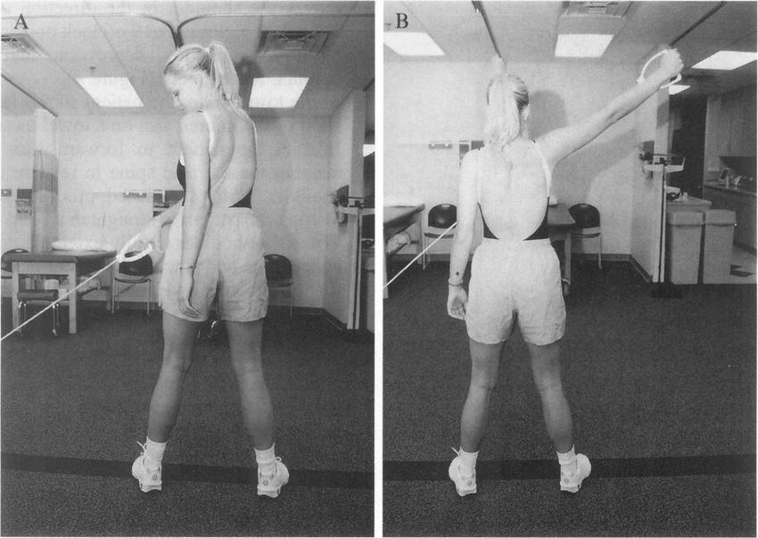
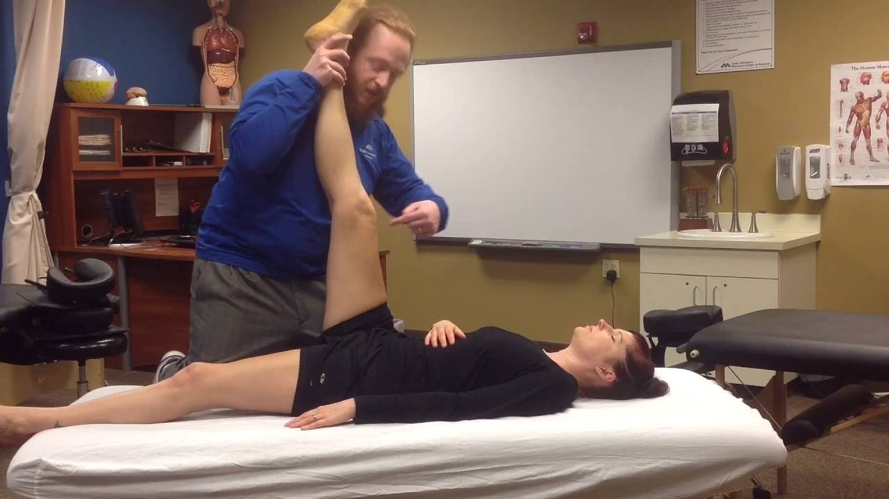
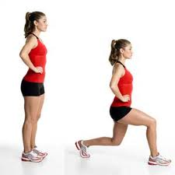
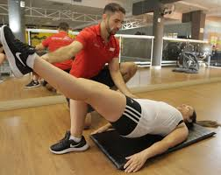
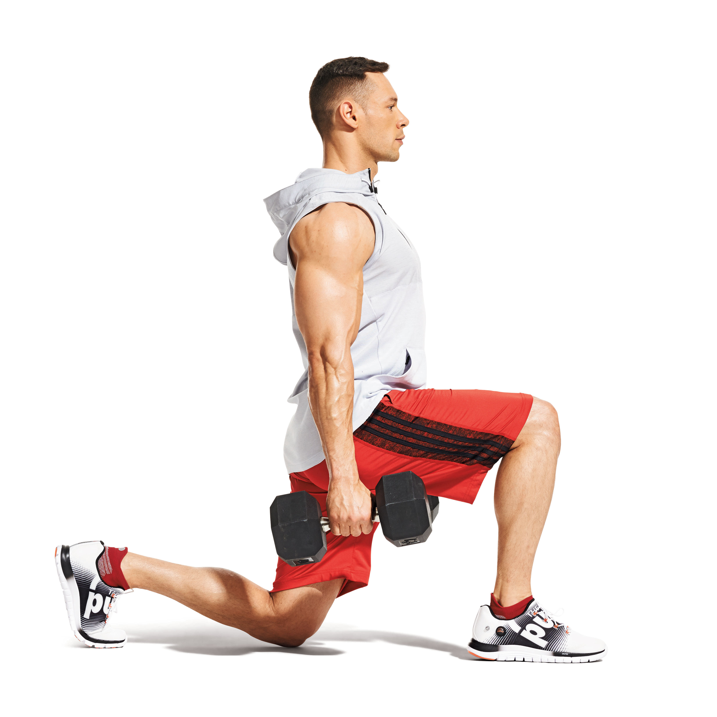
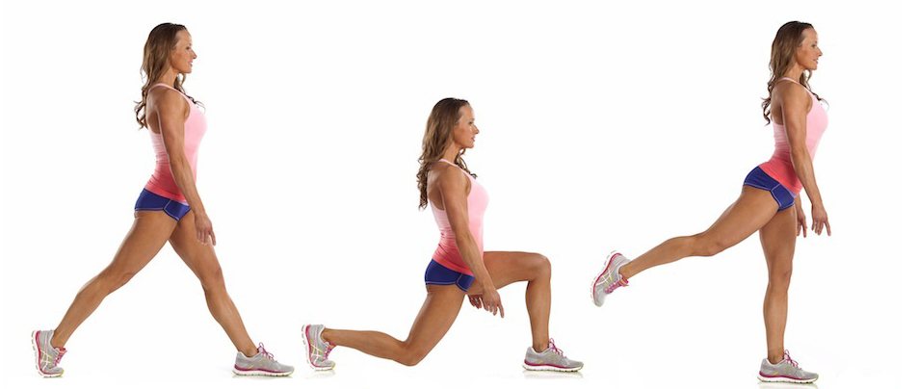

Slide 16
Establishing or Enhancing Core Stability
“Core Stability” is the muscular-based stability of the trunk that keeps our upright posture during activity
Our “core” is the lumbo-pelvic-hip complex where TWENTY NINE muscles originate or insert from!
Lumbar – erector spinae, quadratus lumborum, latissimus dorsi
Pelvic/Abdominal – rectus abdominus, internal & external oblique, transverse abdominus
Stabilize the pelvic floor!
Hip – glutes, iliopsoas
What other important “part of the body” is in the core?
CENTER OF GRAVITY!

Slide 17
True or False?
The core only needs to be strengthened & focused on when the core or back is injured.
Why or why not?

Slide 18
Core Stabilization: The Root of all Level
ALWAYS incorporate core stabilization into the rehab process!
Most people neglect stability to begin with
Abdomen & trunk exercises may not involve the injured extremity anyway!
Athletic mechanics & many functional movements rely on a strong core
Refines acceleration & deceleration of the body
Controls the kinetic chain**
Interconnected segments of the body
The muscles in the extremities can be strong, but if the core is weak they have less force to work with ⟶ inefficient movements ⟶ injury

Slide 19
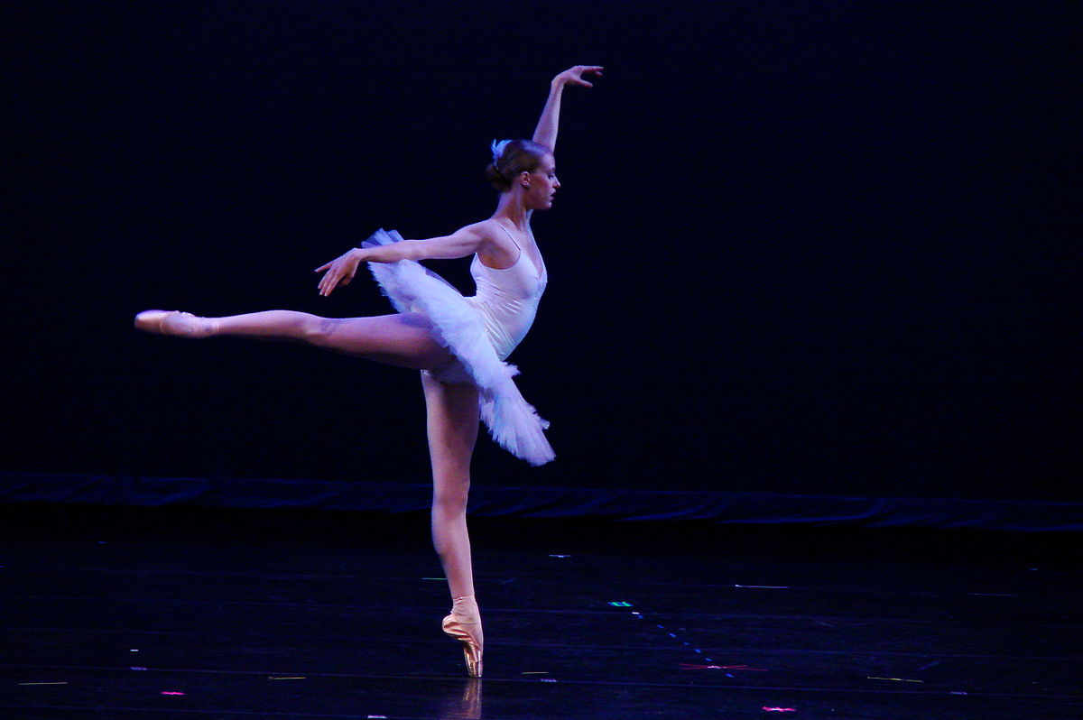
Ubinger, M. 1999. Effect of closed kinetic chain training on neuromuscular control in the upper extremity. Journal of Sports Rehabilitation, p. 184.
Greater neuromuscular control and stabilization strength [of the core] offer a more biomechanically efficient position for the entire
kinetic chain, therefore allowing
optimal neuromuscular efficiency
for the kinetic chain.

Slide 20
How do we do this?
Aim to improve strength, neuromuscular control, power, & endurance of the muscles in the lumbo-pelvic-hip complex to ensure that all of these muscles maintain the proper amount of contraction.
Proper posture!
Exercises HAVE to be safe to perform but also difficult enough to allow the muscles surrounding the core to gain strength!
“Elicit a maximal training response”
Use multi-planar exercises with different types of resistance or surface.
NEVER neglect functional movements!

Slide 21
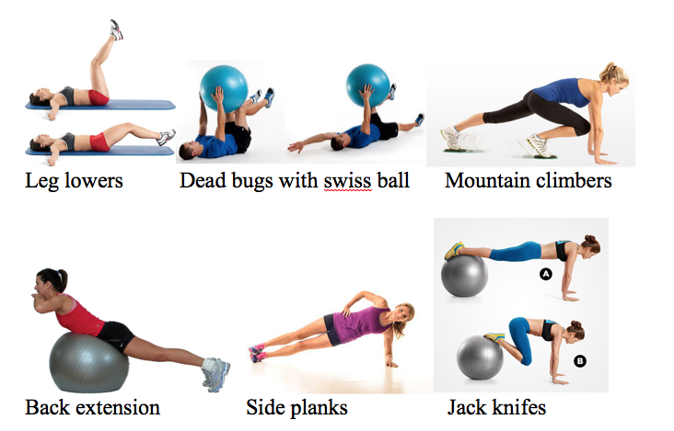
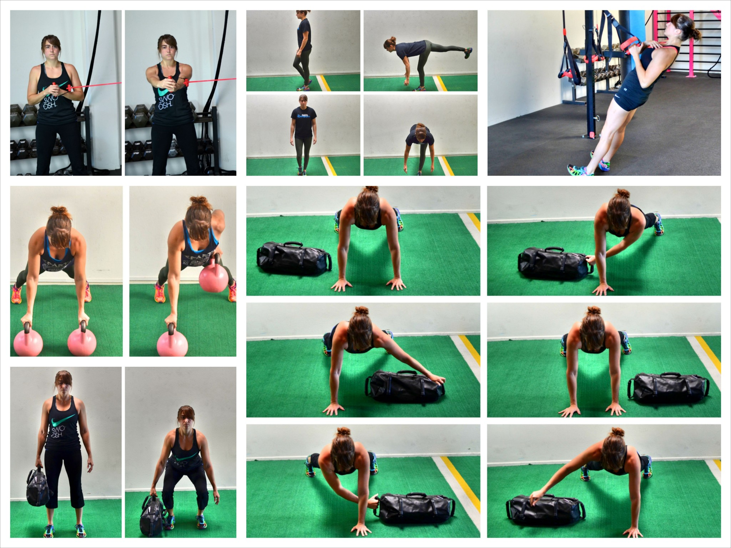
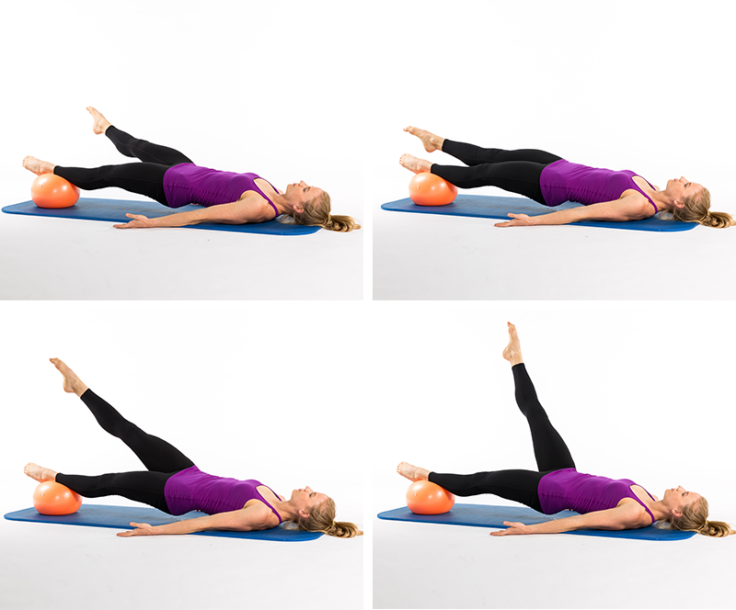
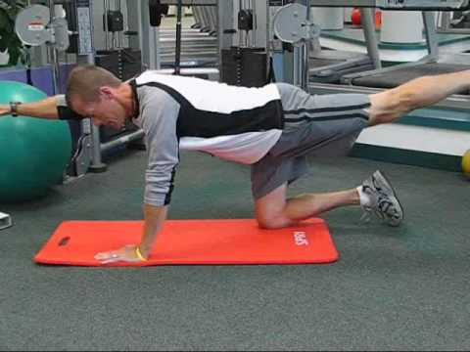
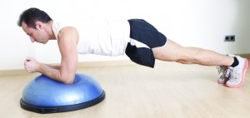

Slide 22
Regaining or Improving Range of Motion
Loss of range of motion is almost unavoidable during injury.
Why?
Involuntary contracture of connective tissue
Resistance to stretch or create force
Pain, swelling, inflammation
All of the above

Slide 23
Types of Range of Motion
Flexion
Extension
Abduction
Adduction
Rotation & circumduction
Spin
Roll
Glide
Physiological Movements:
Muscles contract & pull an extremity in
one direction or another
Accessory Movements:
Involuntary shifting of the articulating surfaces
of bone on one another to allow physiological
movements to occur

Slide 24
HOW to improve Range of Motion
Is a movement restricted because the muscles won’t move or because the bones won’t move?
Range of motion that is limited by physiological movement is best treated by stretching & improving flexibility.
Range of motion that is limited by accessory bone movement is typically best treated by manual joint mobilizations to relieve possible adhesions. “Tight articular structures”
Ligaments
Joint capsule
Muscles
Tendons

Slide 25
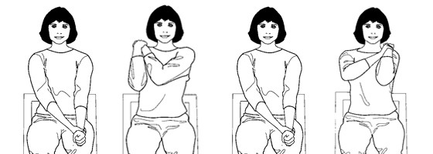
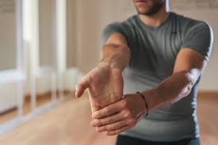
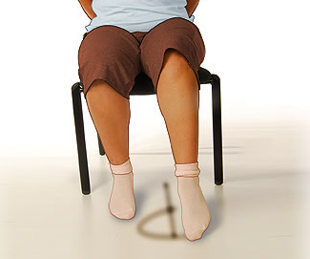
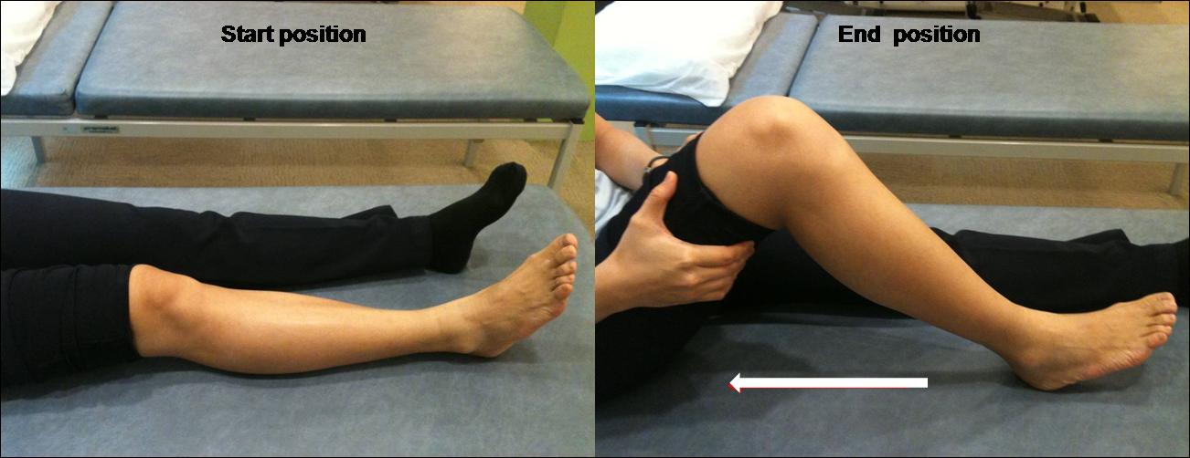
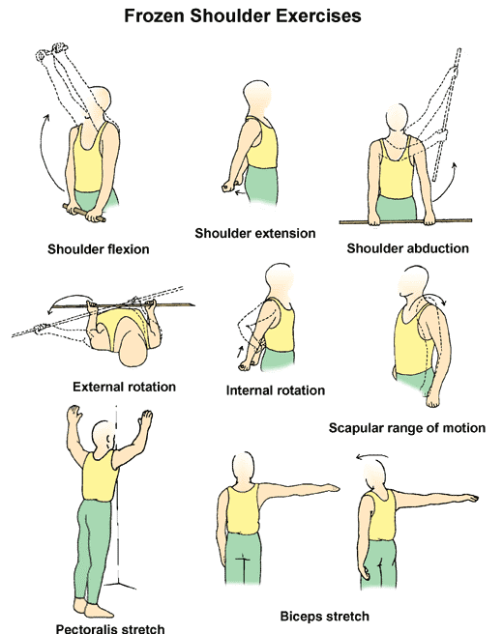
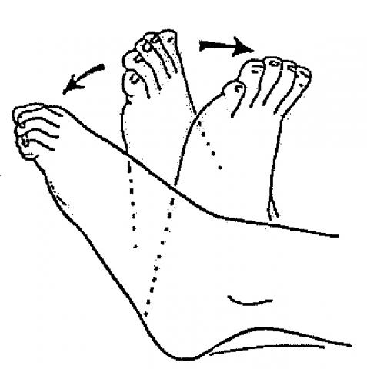
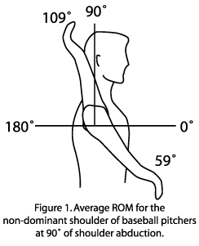
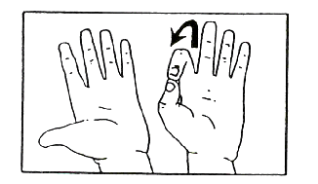

Slide 26
Restoring or Increasing Muscular Strength & Endurance
Muscles begin to atrophy within two weeks of relative inactivity!
Immobilization!
Tissue damage
Pain
Regaining that strength is part of the foundation of returning to pre-injury status.
Do our muscles just simply contract to cause movement?

Slide 27
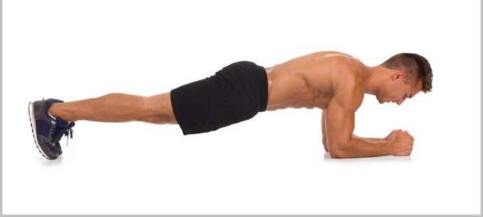
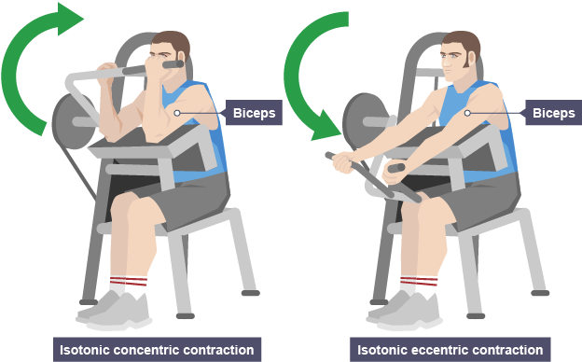
Types of Muscle Strength & Endurance
Isometric contraction
Carrying heavy weight, sitting up straight, standing at work
Isotonic contraction
Lifting heaving things, walking, running, throwing
Concentric contractions require force production to even happen!
Eccentric contraction require strength to decelerate our limbs during dynamic movement!

Slide 28
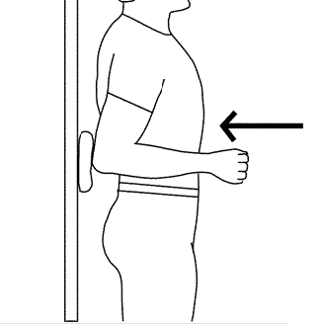
Isometric Strengthening
Use these early!
During the inflammatory phase, tissues want to be kept mostly still.
*Exercises through the full ROM may make the injury worse!
No movement involved, but positive muscle strengthening & re-education.
ONLY static strength is developed
Typically no functional force or eccentric control gained
Mild “pumping” action can pull fluids & swelling that may be trapped.
Quad sets, bridges, wall sits, planks, making a fist, etc.

Slide 29
Concentric Strengthening
USE PROGRESSIVE RESISTANCE!
Heaviest comfortable weight possible for the whole set of the exercise!
Wolff’s Law & SAID principle
Shortening of the muscle creates movement, & muscles can only move things that they have the strength to do.
But did you know, your muscles use less than their maximum contractibility during concentric movement?

Slide 30
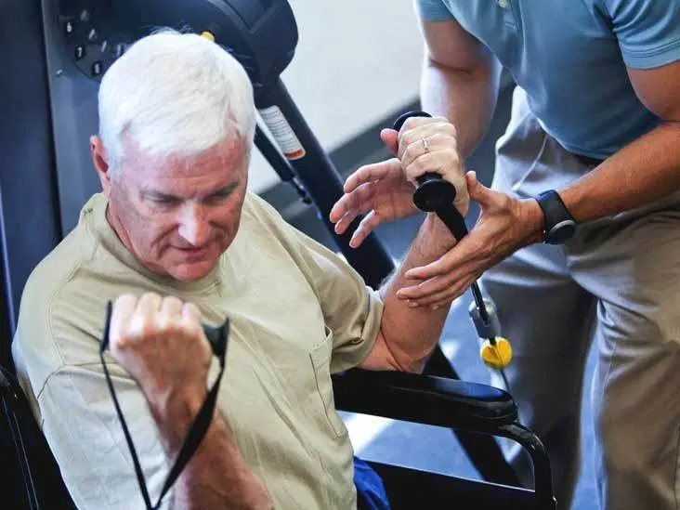
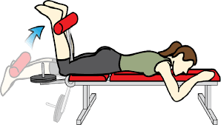
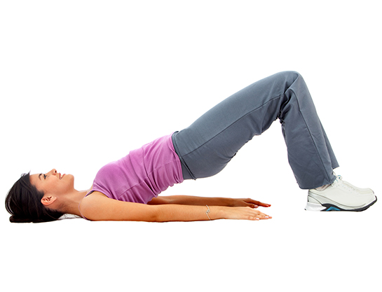
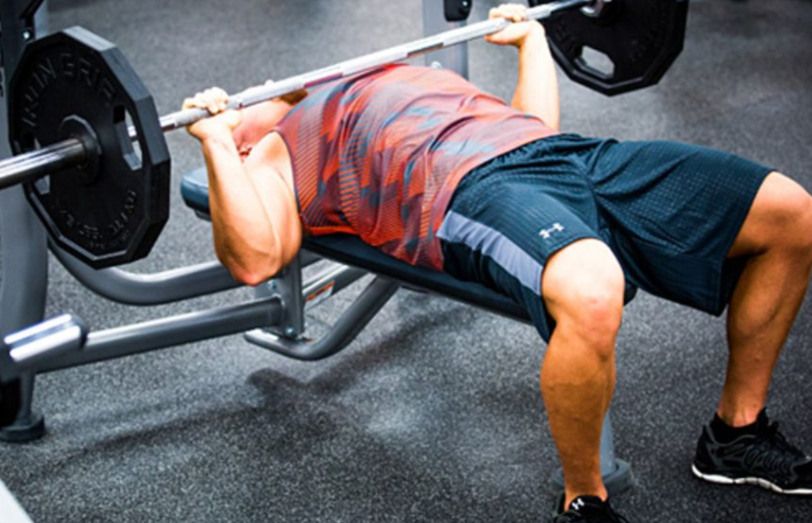
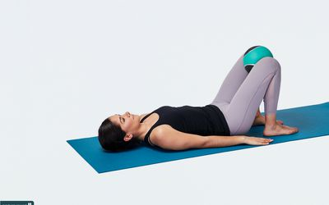

Slide 31
Eccentric Strengthening
Isotonic exercise programs most commonly focus on concentric strengthening & neglect the eccentric control of our muscles.
Slowing down, lowering heavy weights, follow through while throwing a ball
Eccentric contractions can generate & withstand force beyond a muscles maximum strength, meaning we can lower heavier weights than we can lift up.
This also means that a baseball pitcher can throw a ball over 90 mph without his arm flying off…
Without strong eccentric control, muscles don’t have the true strength they need for athletics!

Slide 32
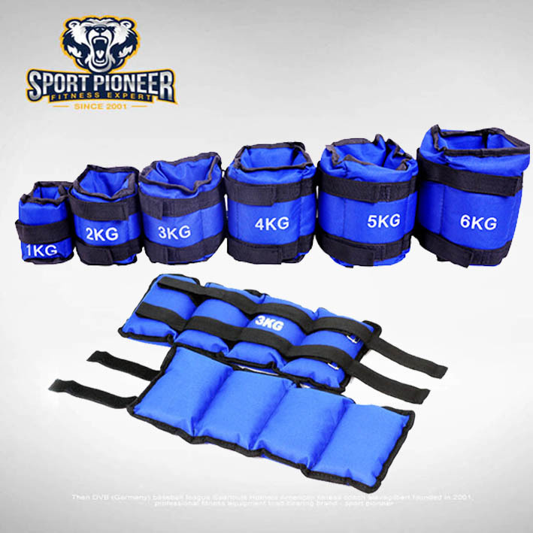
PROGRESSIVE RESISTANCE!

Slide 33
How do we measure strength improvements?
Manual muscle tests!
Focus on all relevant ranges of motion, provide manual resistance, & put the athlete through the motions!
Grade | Percentage | Quality | Muscle Strength
5 | 100% | Normal (WNL) | Complete ROM against gravity with full resistance
4 | 75% | Good | Complete ROM against gravity with some resistance
3 | 50% | Fair | Complete ROM against gravity with no resistance
2 | 25% | Poor | Complete ROM with gravity omitted
1 | 10% | Trace | Evidence of slight contractility with no joint motion
0 | 0% | Zero | No evidence of muscle contractility

Slide 34
Regaining Balance & Postural Control
Neuromuscular function should be reestablished around the injured area as soon after the injury as possible, but regaining total body balance during dynamic movement is completely different
Athletic movements frequently displace the center of gravity & require corrective steps or stumbles
These are reflexive & automatic movements that the brain quickly loses control over following injury!
“The ability to balance & maintain postural control is essential to a patient who is acquiring or reacquiring complex motor skills.”
Balance has to be challenged progressively as more complex skills are being worked into rehabilitation!

Slide 35
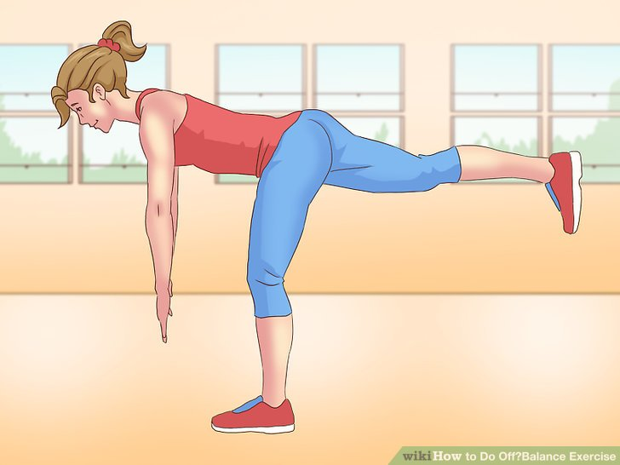
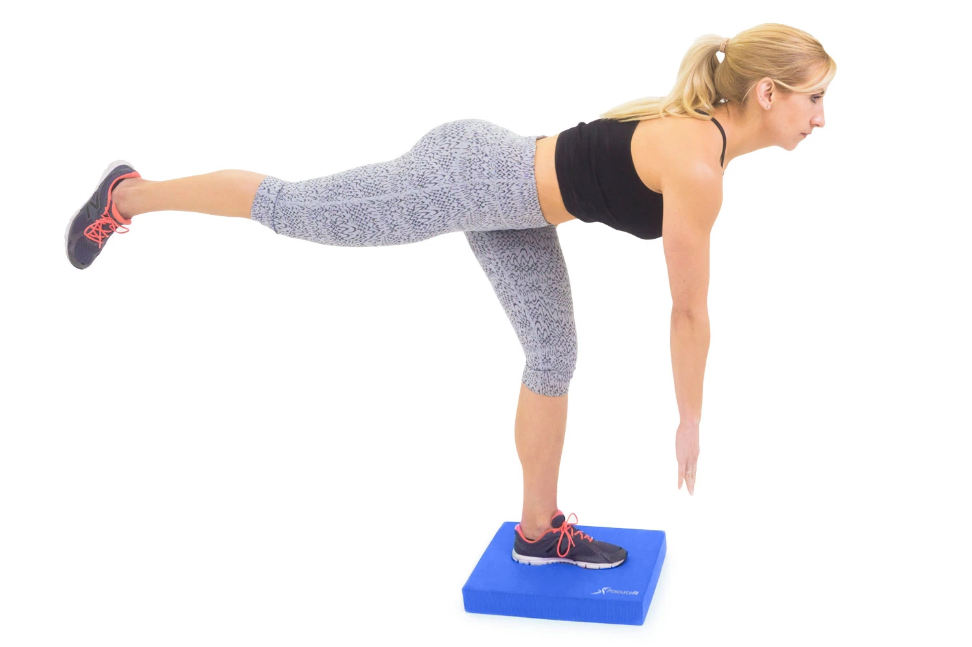
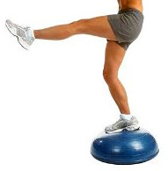
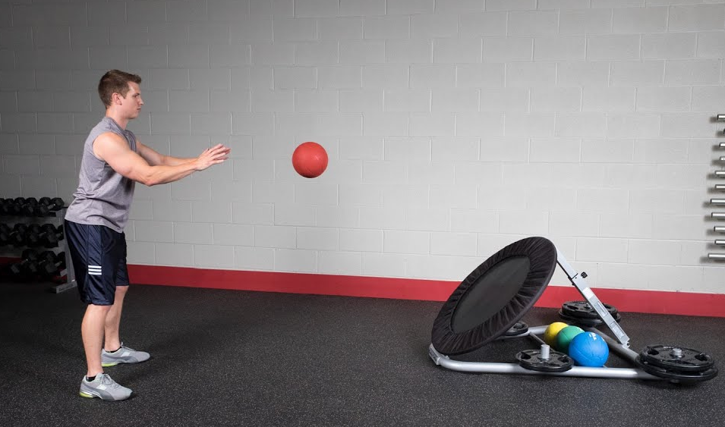
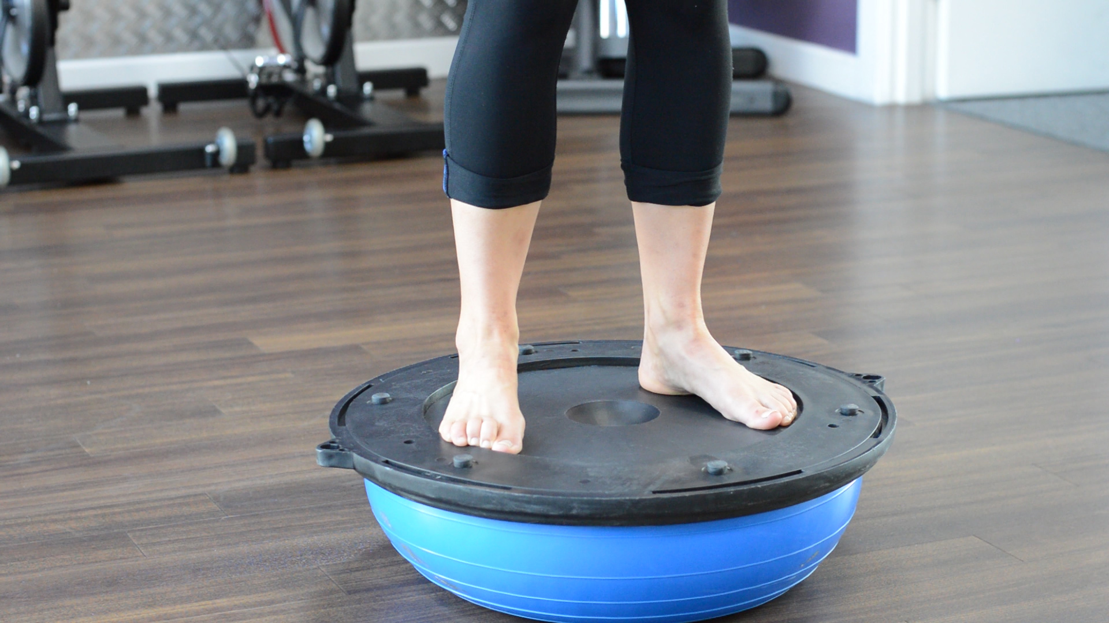

Slide 36
Maintaining Cardiorespiratory Endurance
EVEN athletes can see significant losses in cardiorespiratory endurance after only seven or 14 days of inactivity!
Anything other than average, day-to-day life places increased demands on the cardiorespiratory system that take time to grow accustomed to
During normal, relaxed breathing, your lungs take in ~500mL of air.
During strenuous breathing that goes up to 2-3 liters of air! EACH BREATH!
Put those facts into account with average resting heart rate, & the increase in heart rate while exercising, & see that athletic ability takes A LOT of training.
Hopefully very little re-training throughout a lifetime!

Slide 37
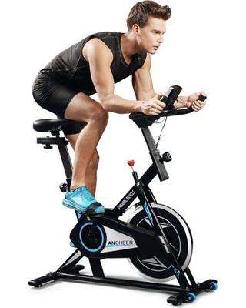
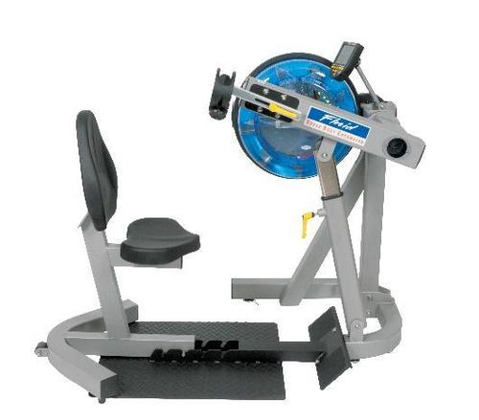
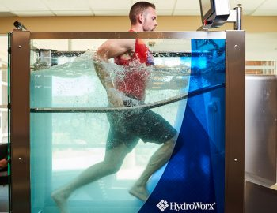
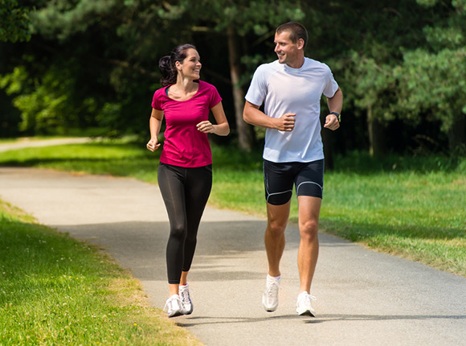
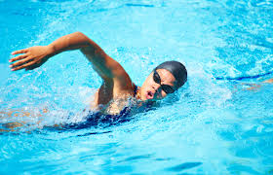

Slide 38
Incorporating Functional Progressions
A functional progression in “a series of gradually [intensifying] activities designed to prepare the individual for return to a specific sport.”
ROM, strength, neuromuscular control
Start AS SOON AS POSSIBLE!
Include every possible skill required for the sport before RTP
Simple to complex skills
Slow to fast speeds
Short to longer distances
Light to heavy activities
PAIN FREE ADVANCEMENTS!

Slide 39
Functional Testing
Provides OBJECTIVE information.
Pain & certain limitations can be bluffed*
Functional tests are measureable or even palpable
Check unilateral & bilateral function & movement in case of compensatory movement.
Utilize any pre-injury measurements possible! Otherwise decisions are made based on “norm” values of each test.
Sprinting tests, agility runs, figure eights, shuttle runs, side stepping, vertical jumps, broad jumps, balance testing
Red flags: pain during testing, unwillingness to perform, next-day inflammation or swelling

Slide 40
Recreated work of Reiman & Manske (2009) http://www.thesportsphysiotherapist.com/functional-performance-testing/

Slide 41
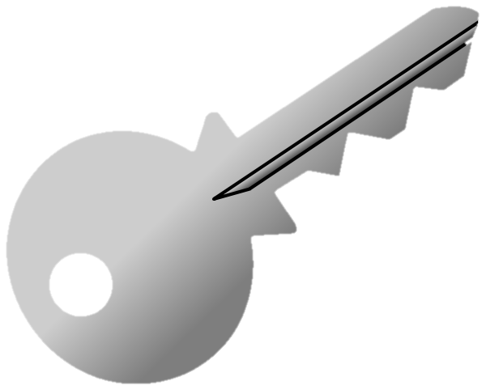
Functional Testing
Progressing someone through rehab takes practice!
Look for deficits
Know what is needed for the sport & position
Be creative with exercises!
Follow up & ask!
The key is, if the current activity or resistance level doesn’t cause any new pain or swelling, the patient can advance!
Advance as frequently as possible!

Slide 42
Functional Movement Screening

Slide 44
Get creative with your rehab!
We’ve discussed several different rehab “tools” already. Now, imagine you don’t have access to ANY!
Pick 10-15 items (random, household, non-traditional) that you think could be used in a rehabilitation program, & EXPLAIN or SHOW how it would work/why it would be useful.

